Slide 1
Scientific Programming
Machine Learning
Ankara Üniversitesi
Bilgisayar Mühendisliği

Slide 2
Machine Learning
Machine learning is programming computers to optimize a performance criterion using example data or past experience.
Examples of machine learning in use:
Prediction
Image Recognition
Speech Recognition
Medical Diagnoses
Financial Industry and Trading

Slide 3
Machine Learning
Optimize a performance criterion using example data or past experience.
Role of Statistics: Inference from a sample
Role of Computer science: Efficient algorithms to
Solve the optimization problem
Representing and evaluating the model for inference

Slide 4
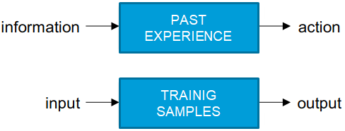
Machine Learning
Design systems that
Automatically take actions (output)
Depending on the environment (input)
Based on their past experience (training samples)

Slide 5
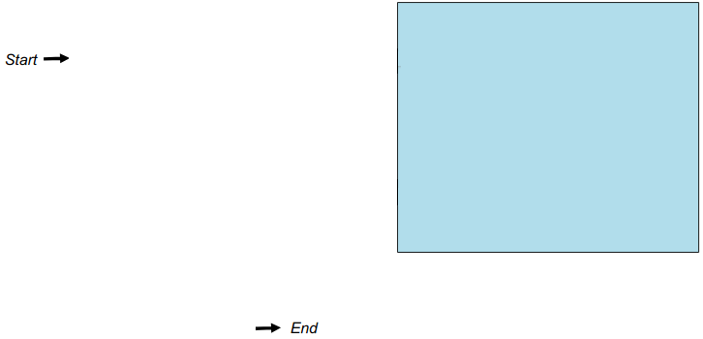
How to design a learning system
Collect data
Choose features
Training
Choose model
Evaluate

Slide 6
Types of Machine Learning
Supervised Learning
Classification
Regression
Unsupervised Learning
Clustering
Association

Slide 7
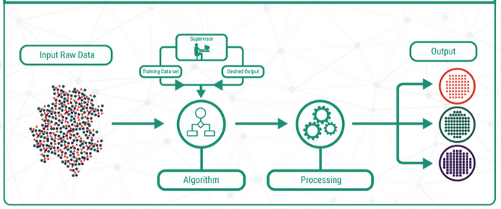
Supervised Learning
Learning a function that maps an input to an output based on example input-output pairs.
Each data tagged with the correct label.
The goal is to approximate the mapping function so well that when you have new input data (x) that you can predict the output variables (y).

Slide 8
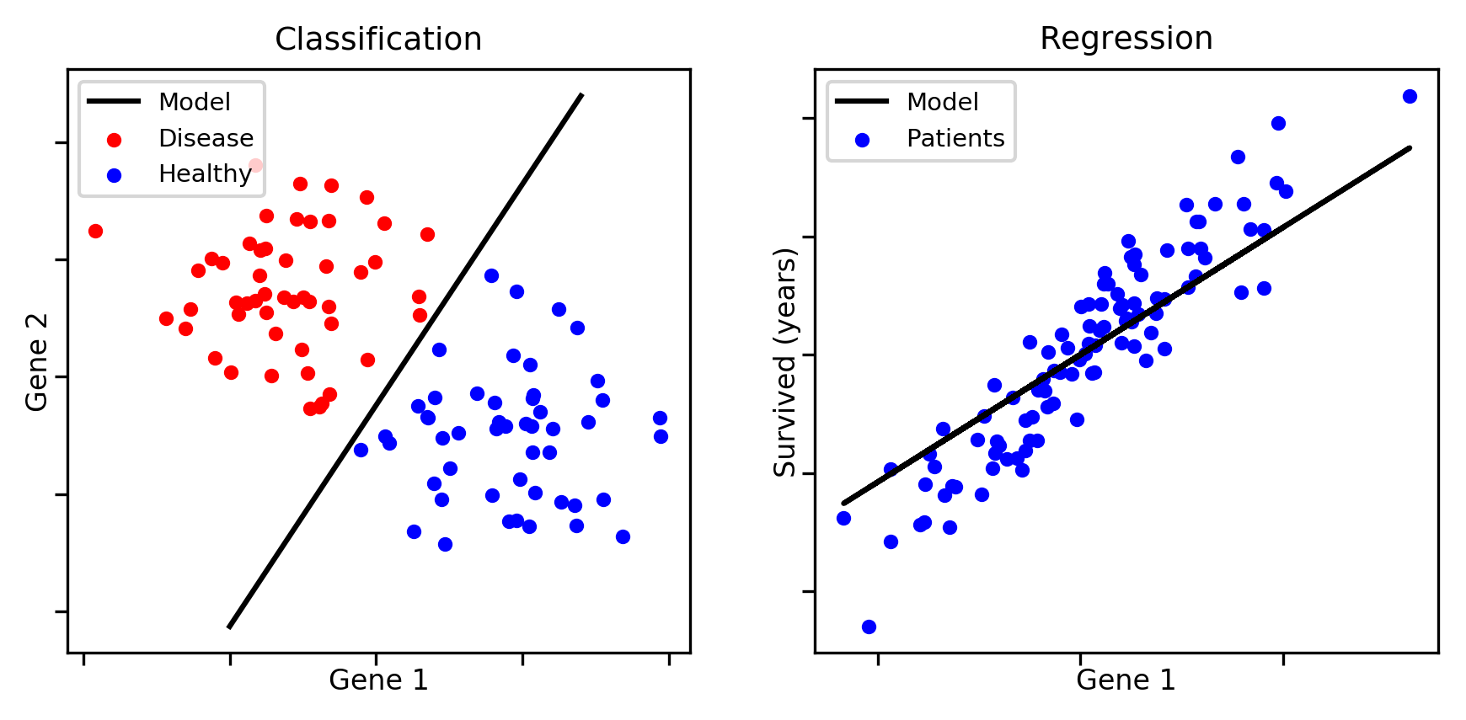
Supervised Learning
Classification: A classification problem is when the output variable is a category, such as “red” or “blue” or “disease” and “no disease”.
Regression: A regression problem is when the output variable is a real value, such as “dollars” or “weight”.

Slide 9
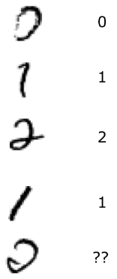
Supervised Learning Example
Digit Recognition
Input: images
Output: a digit (between 0 and 9)
Setup:
Get a large collection of example images, each labeled with a digit.
Someone has to hand label all this data!
Want to learn to predict labels of new, digit images.
Features: Pixels, shape patterns such as number of components, number of loops, etc.

Slide 10
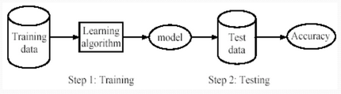
Supervised Learning process
Learning/Training: Training a model using training data.
Testing: Test the model using unseen test data to calculate the accuracy
Accuracy =
Number of correct classifications
Total number of test cases

Slide 11
Classification Techniques
Support vector machine (SVM),
Decision trees,
Naive Bayes,
K-nearest Neighbor
Logistic regression
Artificial neural networks

Slide 12
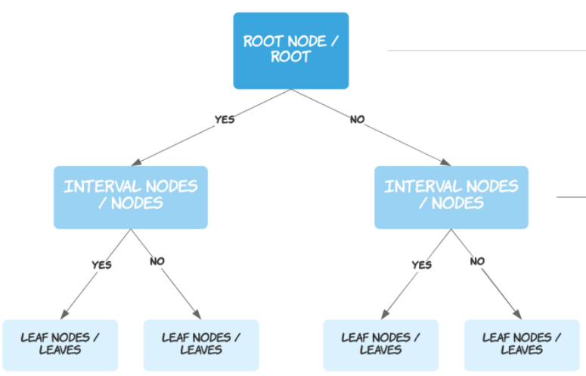
Decision Tree

Slide 13
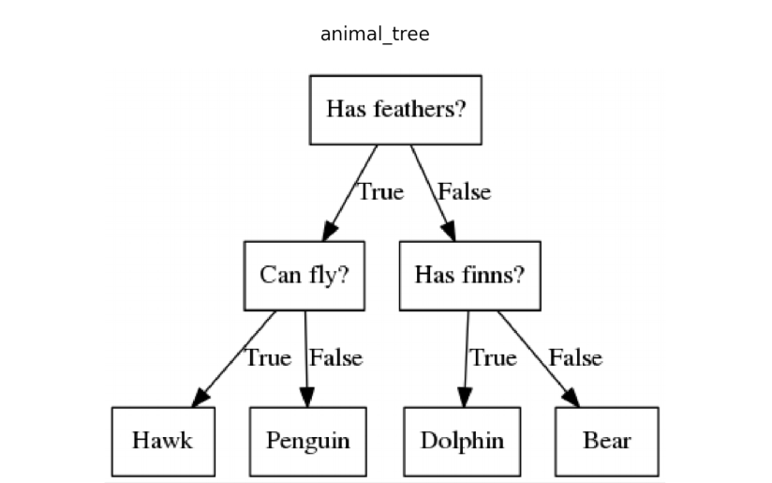
Decision Tree

Slide 14
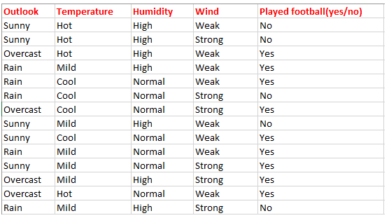
Decision Tree
Determine whether to play football or not.

Slide 15
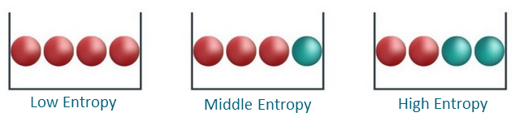
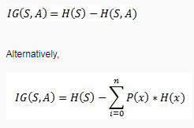

Decision Tree-Entropy
Entropy is a measure of disorder or uncertainty

Slide 16

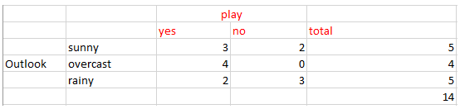
Decision Tree-Entropy
Find the entropy of the class variable (9 YES, 5 NO)
H(S) = -[(9/14)log(9/14) + (5/14)log(5/14)] = 0.94
Now we have to calculate average weighted entropy.
H(S, outlook) = (5/14)*E(3,2) + (4/14)*E(4,0) + (5/14)*E(2,3)
= (5/14)(-(3/5)log(3/5)-(2/5)log(2/5))+ (4/14)(0) +
(5/14)(-(2/5)log(2/5)-(3/5)log(3/5)) = 0.693

Slide 17

Decision Tree-Entropy
Find the entropy of the class variable (9 YES, 5 NO) 0.94
Now we have to calculate average weighted entropy.
H(S, outlook) = 0.693
H(S, Temperature) = 0.911
H(S, Humidity) = 0.788
H(S, Windy) = 0.8932
The next step is to find the information gain. It is the difference between parent entropy and average weighted entropy we found above.
IG(S, outlook) = 0.94 - 0.693 = 0.247
IG(S, Temperature) = 0.940 - 0.911 = 0.029
IG(S, Humidity) = 0.940 - 0.788 = 0.152
IG(S, Windy) = 0.940 - 0.8932 = 0.048

Slide 18
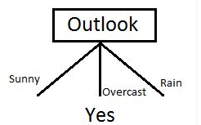
Decision Tree-Entropy
Calculate parent entropy E(sunny)
H(sunny) = (-(3/5)log(3/5)-(2/5)log(2/5)) = 0.971.
Calculate the information gain of Temperature
H(sunny, Temperature) = (2/5)*E(0,2) + (2/5)*E(1,1) + (1/5)*E(1,0)=2/5=0.4
IG(sunny, Temperature) = 0.971–0.4 =0.571
Similarly we get
IG(sunny, Humidity) = 0.971
IG(sunny, Windy) = 0.020

Slide 19

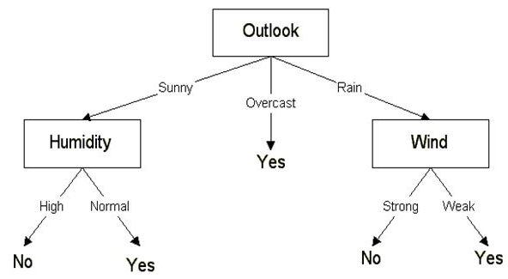
Decision Tree-Entropy

Slide 20
Decision Tree - MATLAB
tree = fitctree(X,Y) returns a fitted binary classification decision tree based on the input variables contained in matrix X and output Y.
https://www.mathworks.com/help/stats/fitctree.html

Slide 21
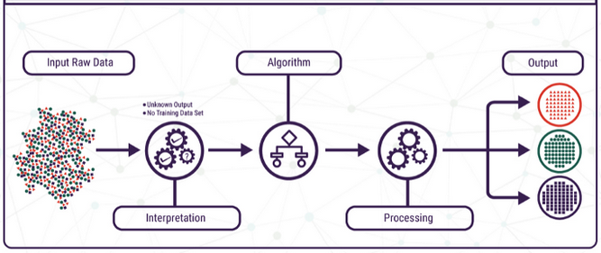
Unsupervised Learning
Training data is unlabeled, uncategorized.
The system tries to learn without prior training.
It is a type of Machine Learning that converts raw data into organized data.

Slide 22
Unsupervised learning
Types of Unsupervised learning
Association: An association rule learning problem is where you want to discover rules that describe large portions of your data, such as people that buy X also tend to buy Y.
Clustering: A clustering problem is where you want to discover the inherent groupings in the data, such as grouping customers by purchasing behavior.

Slide 23
K-means Clustering
The K-Means algorithm is an unsupervised learning and clustering algorithm.
The K value in K-Means determines the number of clusters and should take this value as a parameter.
After the K is determined, it randomly selects K center points in the algorithm.
It calculates the distance between each data and randomly determined center points and assigns the data to a cluster according to the closest center point.
Then a center point is selected again for each cluster and clustering process is performed according to the new center points.
This situation continues until the system becomes stable.

Slide 24
K-means Clustering
Pros.
Fast and efficient.
Works on unlabeled numerical data.
Iterative technique.
Cons.
Have to choose your own k value.
Lots of repetition.
Does not perform well when outliers are present.

Slide 25
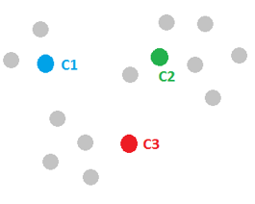
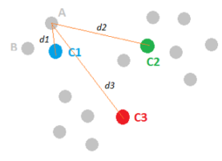
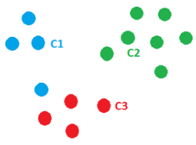
Steps to Creating a K-Means Model
There are three main steps when using the k-means clustering technique.
Step #1: Pick K random points as cluster centers
Step #2:
Assign data instances to closest mean
Assign each mean to the average of its assigned points

Slide 26
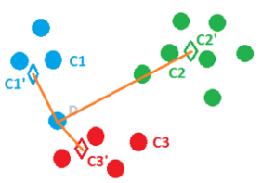
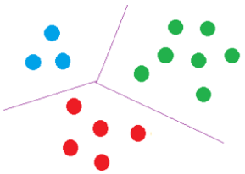
Steps to Creating a K-Means Model
There are three main steps when using the k-means clustering technique.
Step #3: Stop when no points’ assignments change

Slide 27

The Mathematics Behind K-Means
ın Step #2, calculate distance between data points and centroids using Euclidean distance.
Change the cluster center to the average of the assigned points

Slide 28
Numerical Example
8 points, 3 clusters
A1=(2,10), A2=(2,5), A3=(8,4), A4=(5,8), A5=(7,5), A6=(6,4), A7=(1,2), A8=(4,9)
Randomly selected initial centers: A1, A4, A7
 | A1 | A2 | A3 | A4 | A5 | A6 | A7 | A8
Center 1 (2, 10) | 0 | 5 | 6 | 3,60 | 7,07 | 7,21 | 8,06 | 2,23
Center 2 (5,8) | 3,60 | 4,24 | 5 | 0 | 3,60 | 4,12 | 7,21 | 1,41
Center 3 (1,2) | 8,06 | 3,16 | 7,28 | 7,21 | 6,70 | 5,38 | 0 | 7,61

Slide 29
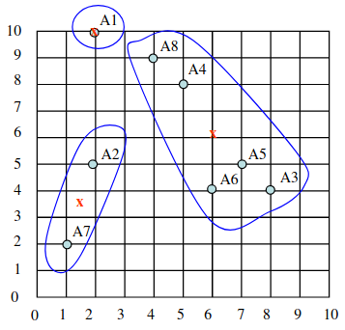
Numerical Example
Centers of the new clusters:
C1= (2, 10)
C2= ((8+5+7+6+4)/5, (4+8+5+4+9)/5) = (6, 6)
C3= ((2+1)/2, (5+2)/2) = (1.5, 3.5)

Slide 30
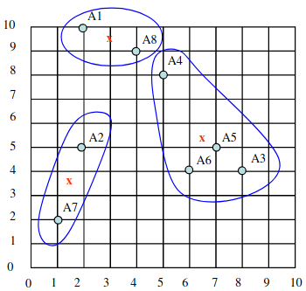
Numerical Example
After the 2nd epoch the results would be:
Cluster 1: {A1, A8},
Cluster 2: {A3, A4, A5, A6},
Cluster 3: {A2, A7} with centers
C1=(3, 9.5), C2=(6.5, 5.25) and C3=(1.5, 3.5).

Slide 31
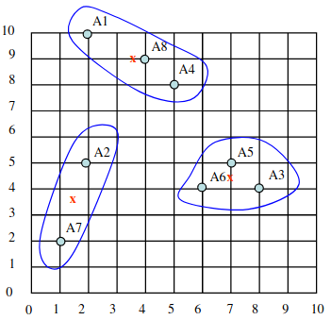
Numerical Example
After the 3rd epoch, the results would be:
Cluster 1: {A1, A4, A8},
Cluster 2: {A3, A5, A6},
Cluster 3: {A2, A7} with centers
C1=(3.66, 9), C2=(7, 4.33) and C3=(1.5, 3.5).

Slide 32
K-means - MATLAB
while(1)
prev = center;
for i = 1:data_size
for j = 1:clusters
dis(i, j) = norm(data(i,:) - center(j, :));
end
end
for i = 1:data_size
label(i) = find(dis(i,:) == min(dis(i,:)));
end
for i = 1:clusters
cluster_members = data(find(label==i), :);
center(i, :) = mean(cluster_members);
end
if (center == prev)
break;
end
end
end
function [label, step] = k_means(data, clusters, num)
ind = randperm(data_size, clusters);
center = data(ind, :);
dis = zeros(data_size, clusters);
label = zeros(data_size, 1);

Slide 33
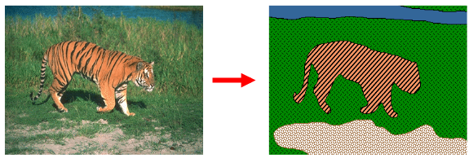
Example: Image Segmentation
What is Image Segmentation?
“the process of partitioning a digital image into multiple segments”
The segmentation is based on measurements taken from the image
graylevel, colour, texture, depth or motion, position

Slide 34
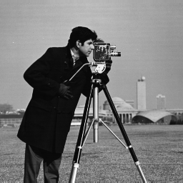
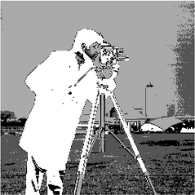
Segmentation with K-means MATLAB
I=imread('cameraman.png');
I = double(I);
nrows = size(I,1);
ncols = size(I,2);
I = reshape(I, nrows*ncols, 1);
nColors = 4;
[cluster_idx, cluster_center] = kmeans(I, nColors);
pixel_labels = reshape(cluster_idx, nrows, ncols);
imshow(pixel_labels,[]);

Slide 35
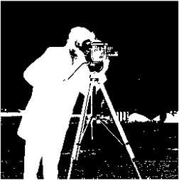
Segmentation with K-means MATLAB
I=imread('cameraman.png');
I = double(I);
nrows = size(I,1);
ncols = size(I,2);
I = reshape(I, nrows*ncols, 1);
nColors = 2;
[cluster_idx, cluster_center] = kmeans(I, nColors);
pixel_labels = reshape(cluster_idx, nrows, ncols);
imshow(pixel_labels,[]);

